Slide 1
EDA on Airbnb dataset
By-Ritwik Kumar
Data Science Intern,
Team Satyarth

Slide 2
About The data Set
Airbnb is an online marketplace that connects people who want to rent out their homes with people looking for accommodations in that locale. NYC is the most populous city in the United States, and one of the most popular tourism and business places globally.
Since 2008, guests and hosts have used Airbnb to expand on traveling possibilities and present a more unique, personalized way of experiencing the world. Nowadays, Airbnb became one of a kind service that is used by the whole world. Data analysts become a crucial factor for the company that provided millions of listings through Airbnb. These listings generate a lot of data that can be analyzed and used for security, business decisions, understanding of customers’ and providers’ behavior on the platform, implementing innovative additional services, guiding marketing initiatives, and much more.

Slide 3
Libraries Used
PANDAS
NUMPY
MATPLOTLIB
MATPLOTLIB.PYPLOT
SEABORN

Slide 4
Data Loading , Profiling and Cleansing
We have 4 columns contain a missing value. Now, we drop unnecessary columns such as id, name, host_name, last_review.
Replacing all NaN values in “review_per_month_ with 0
We haven’t missed value anymore.

Slide 5
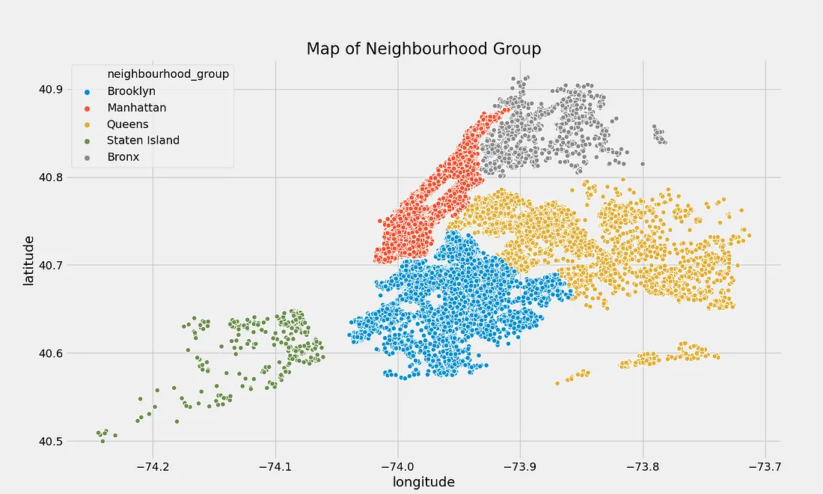
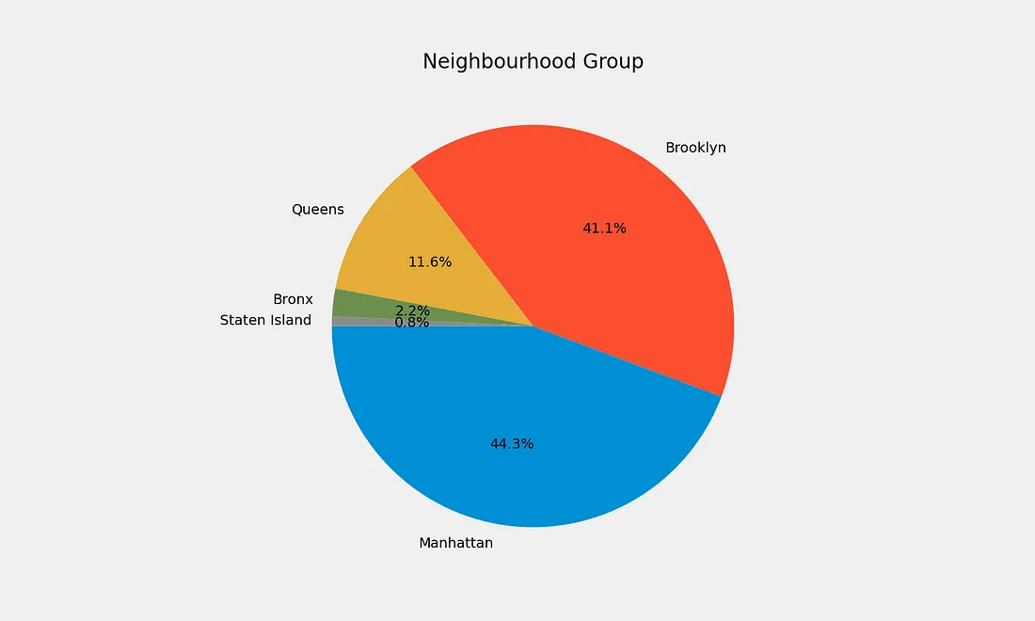
Exploration Data and Visualizing
Now time to explore our data and visualize it to recognize the relationship between the dataset.
Neighbourhood Group
The pie chart above shows that Airbnb Listings in Newyork are near Manhattan, and Brooklyn has the highest share of hotels. We also know that from this map of Neighborhood Group

Slide 6
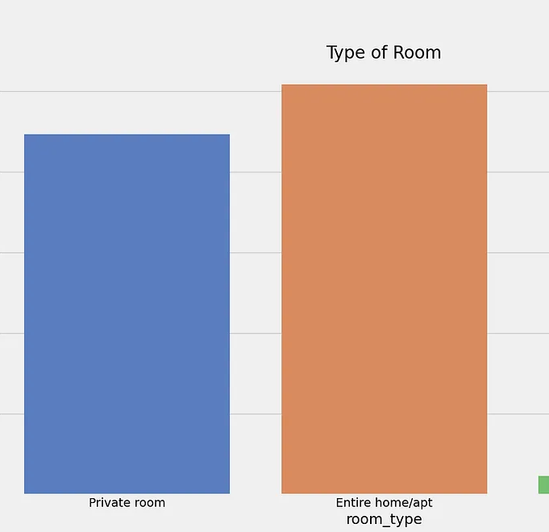
2) Room Details
Let’s see the type of room.
We can see that the Entire Home/Apartment has the highest share, followed by the Private Room, and the least preferred is Shared Room.

Slide 7
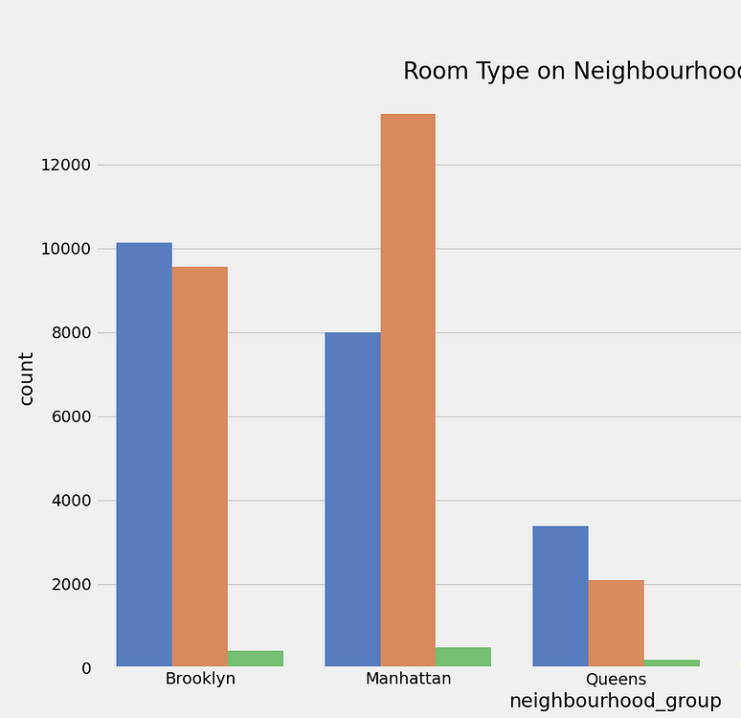
Continued……
Let’s see room types occupied by a neighbourhood group.
The graph shows that the Entire Home/Apartment is listed most near Manhattan, while Private Rooms and Apartments Near Brooklyn are Nearly equal.

Slide 8
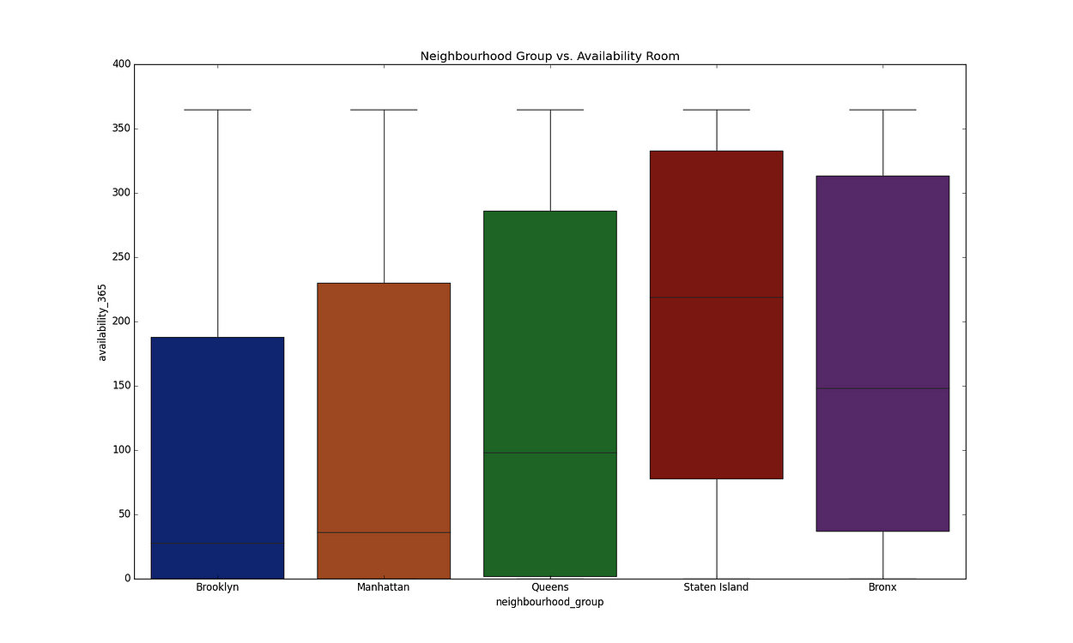
3) Neighborhood Group vs. Availability Room
The graph above shows the relationship between the availability room and neighborhood group

Slide 9
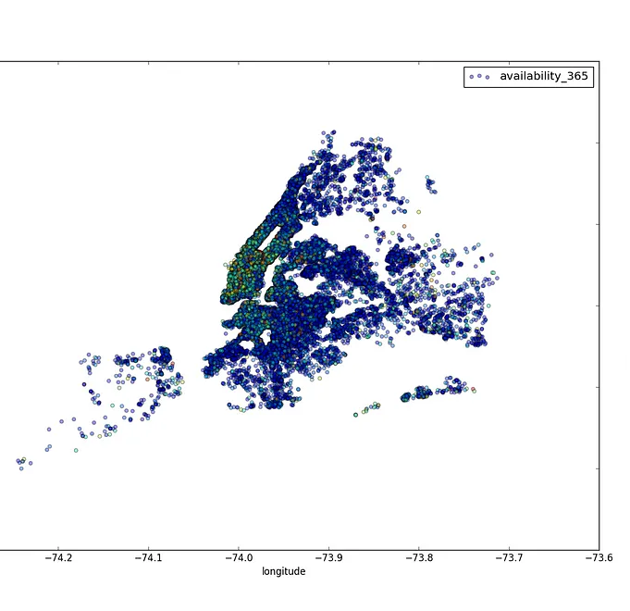
4 ) Neighborhood Group Price Distribution
The information we got from the graph above is red color dots are the rooms with a higher price. Also, we can see that the Manhattan region has a more expensive room price.

Slide 10
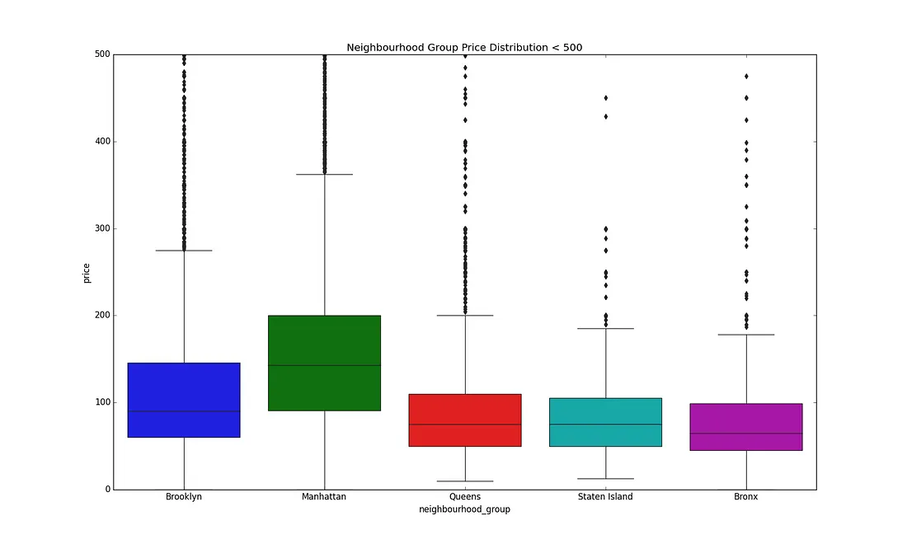
Continued….
From the boxplot above, we can definitely observe a couple of things about the distribution of prices for Airbnb in NYC.
We can state that Manhattan has the highest range price for the listings with about $140 as an average price, followed by Brooklyn with $90 per night,
Queens and Staten Island seem to have a very similar distribution,
The Bronx is the cheapest.

Slide 11
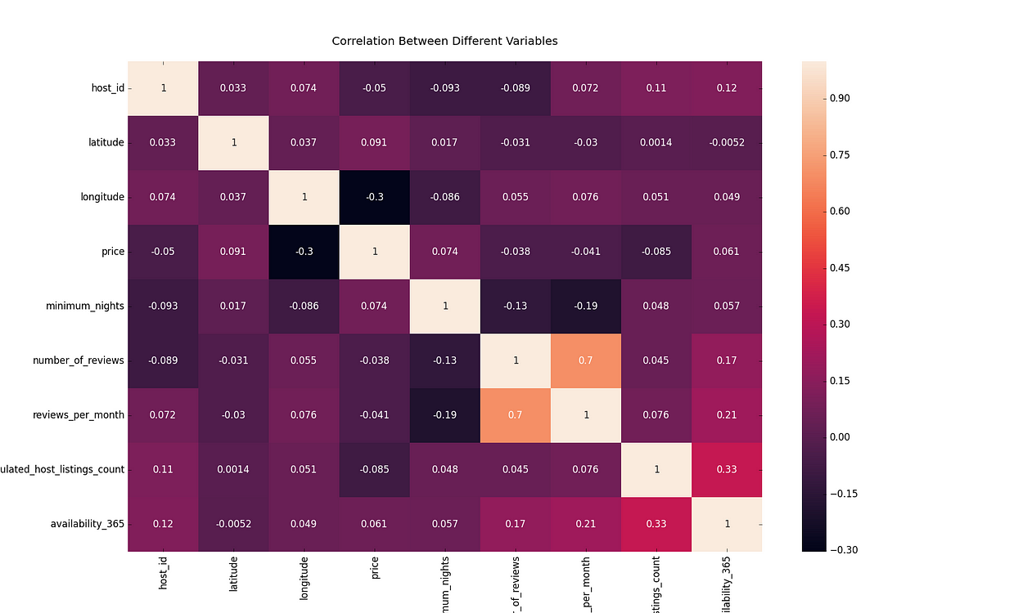
5) Price Prediction
Let’s see the correlation between the columns
From the graph above, we know that there is not a strong correlation except review_per_month and number_of_review.

